Slide 1

Toolkit Doc9 Bellows
April 29, 2010

Slide 2
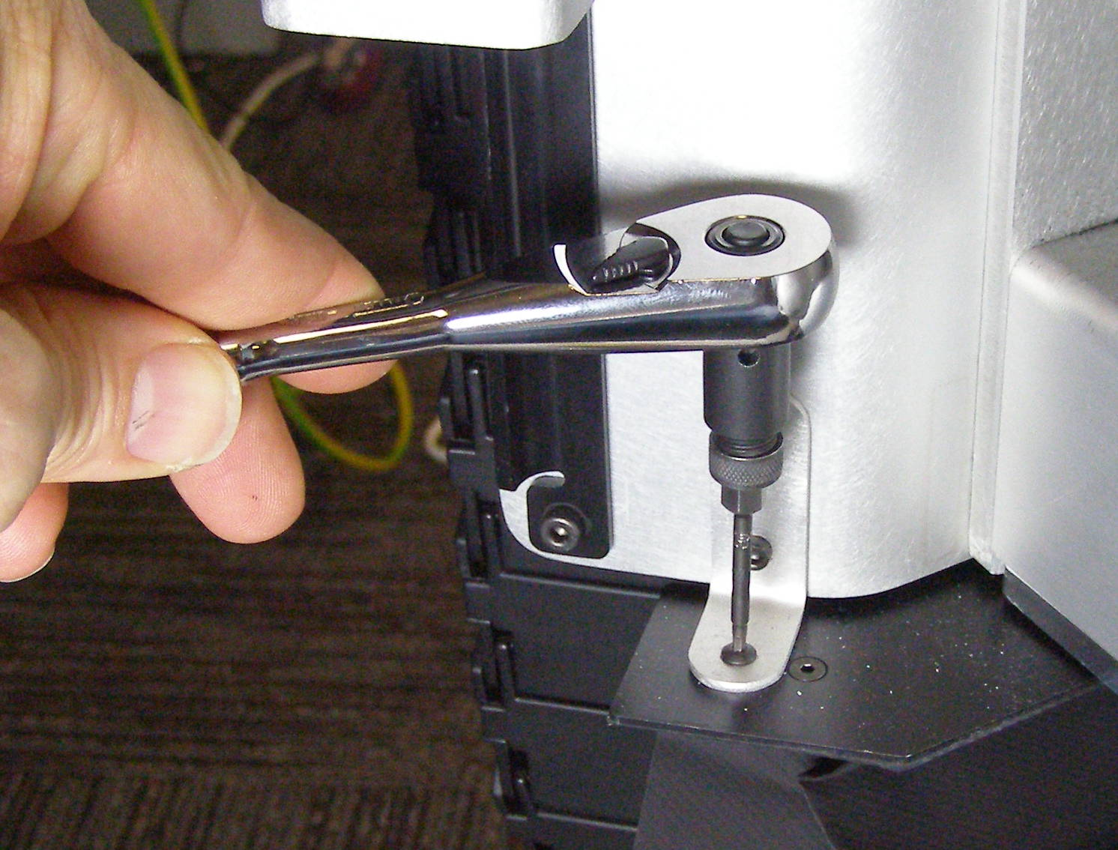
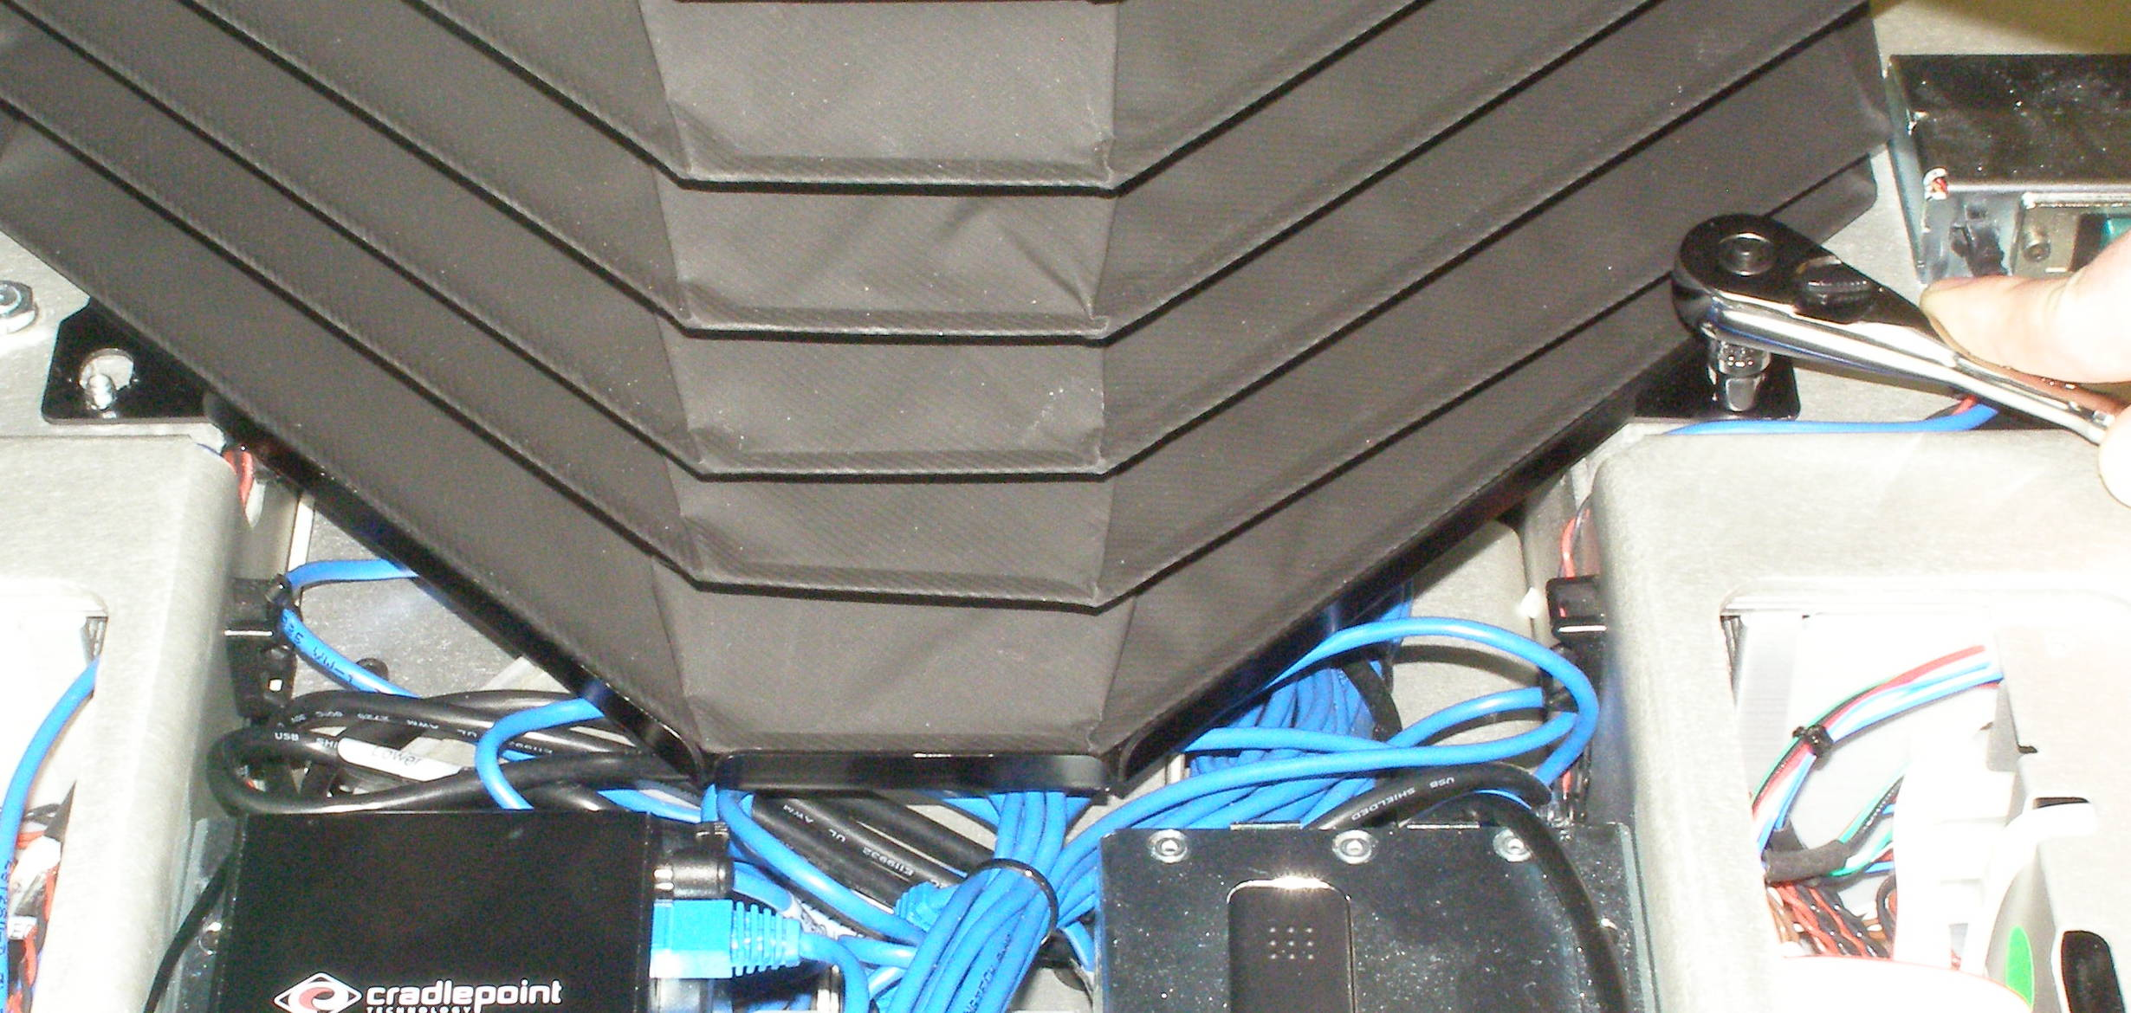
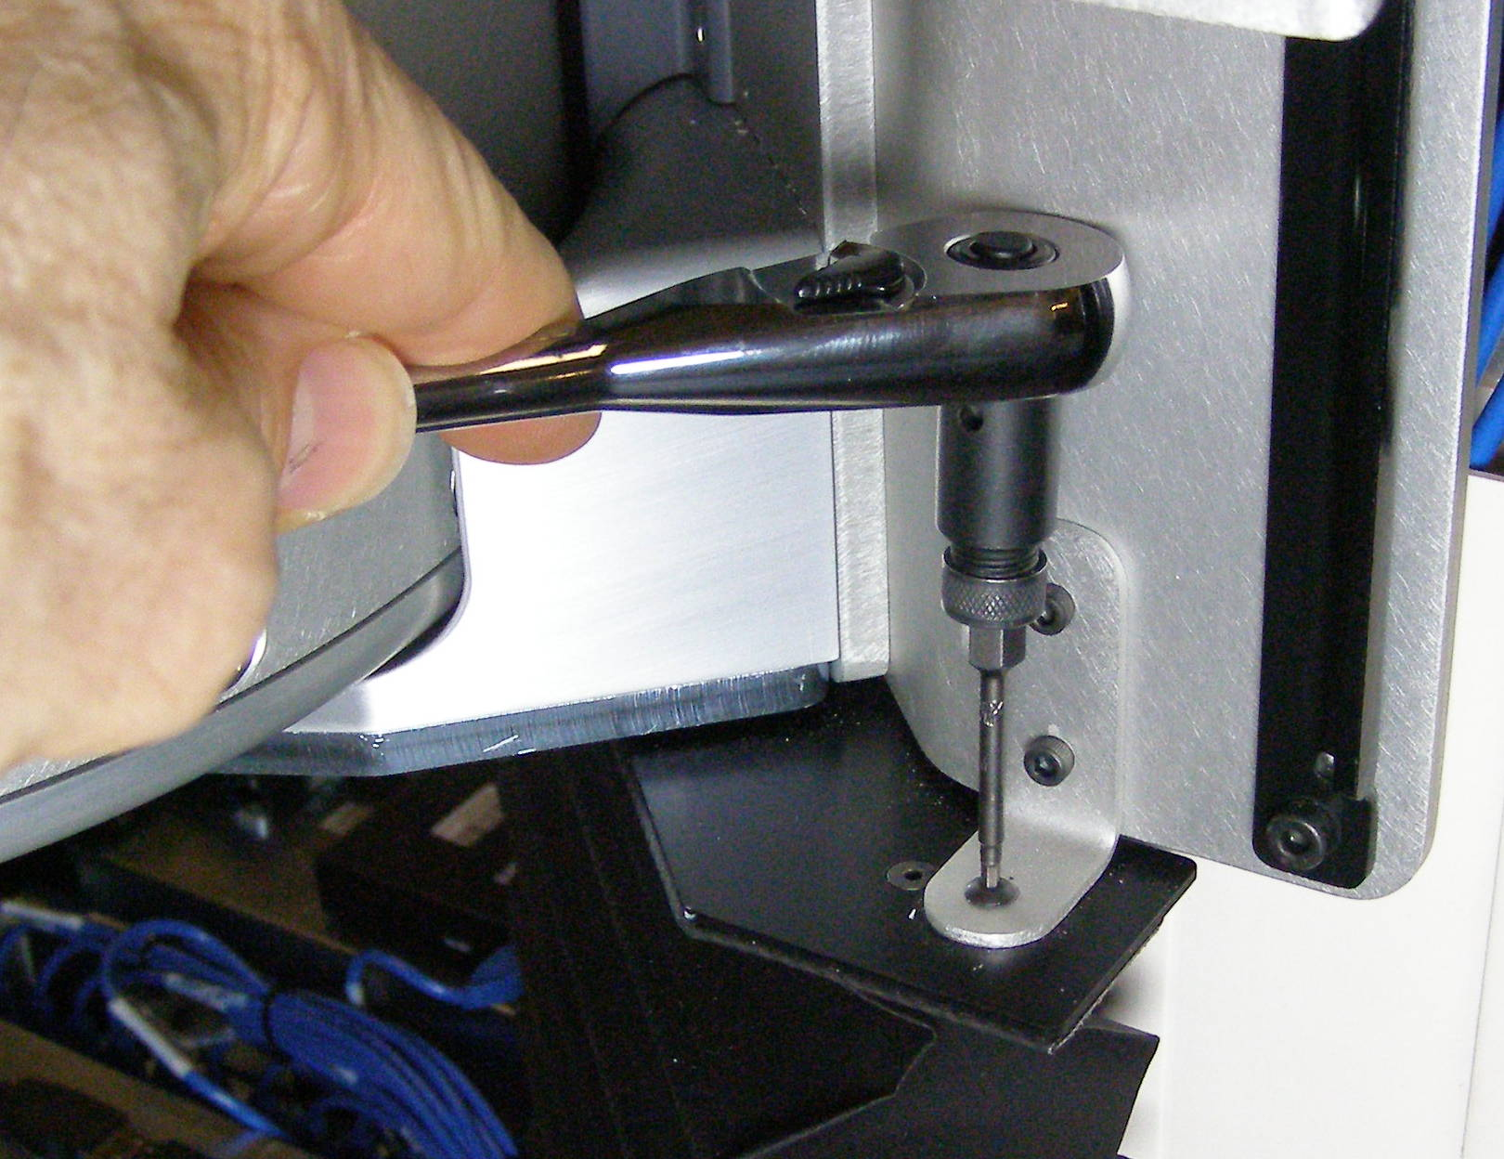
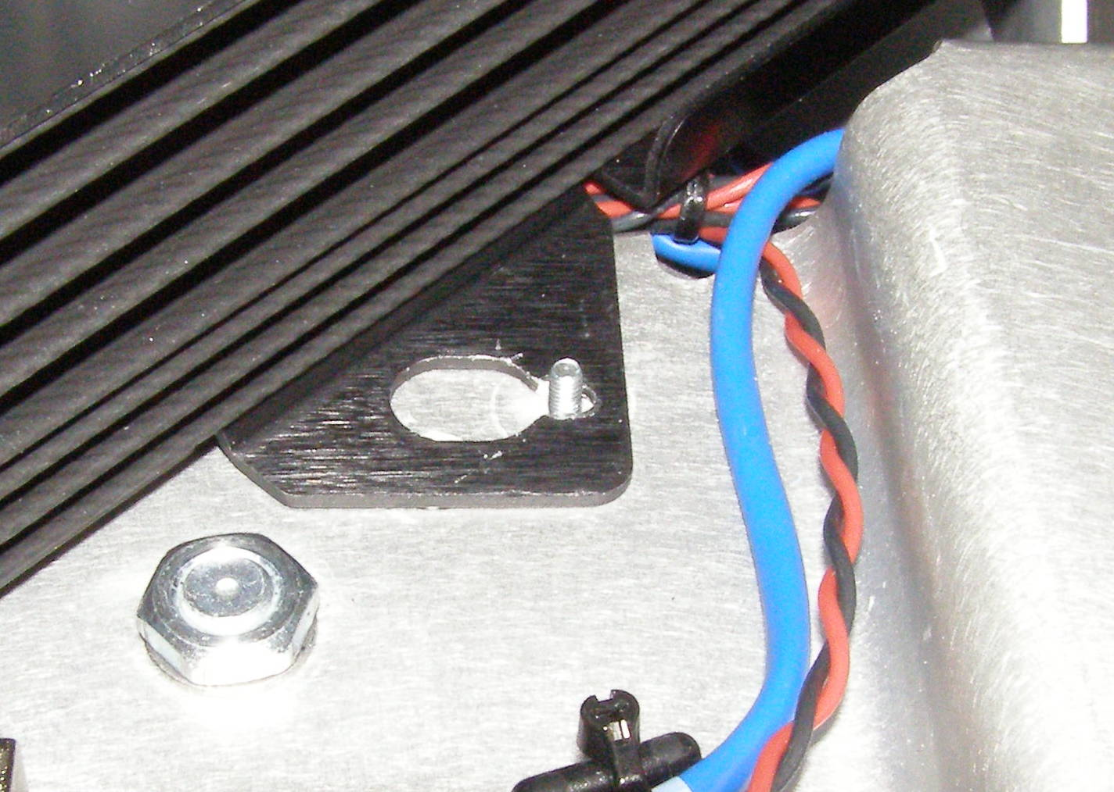
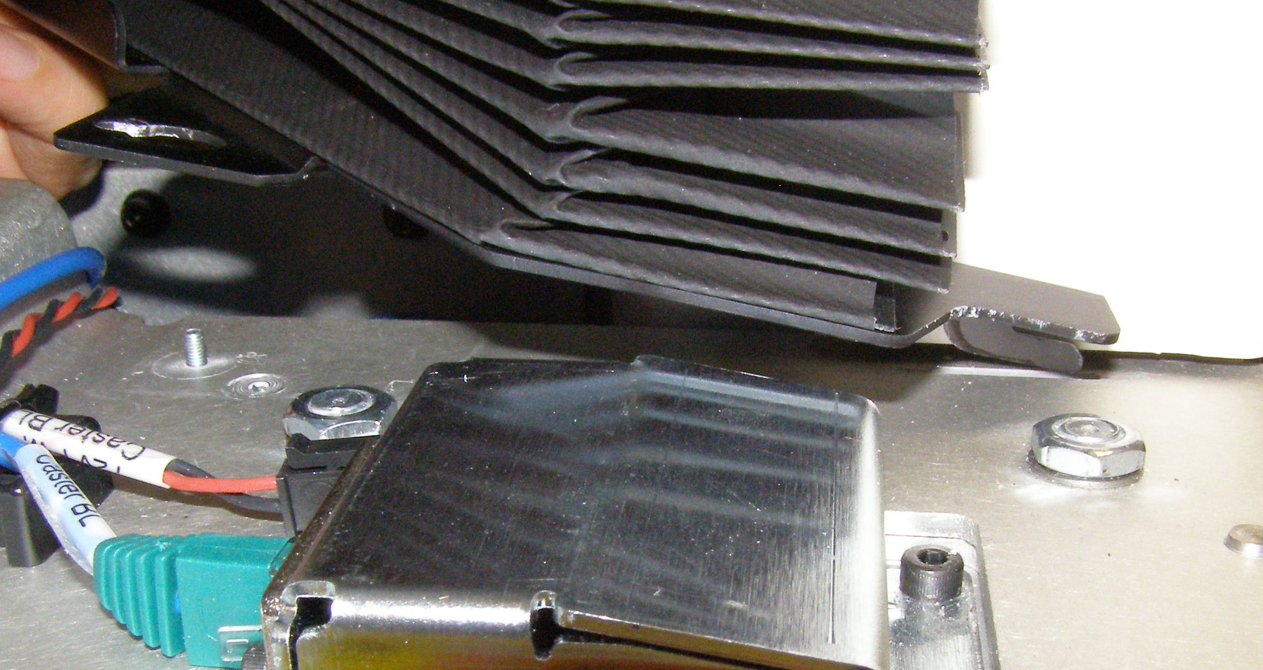
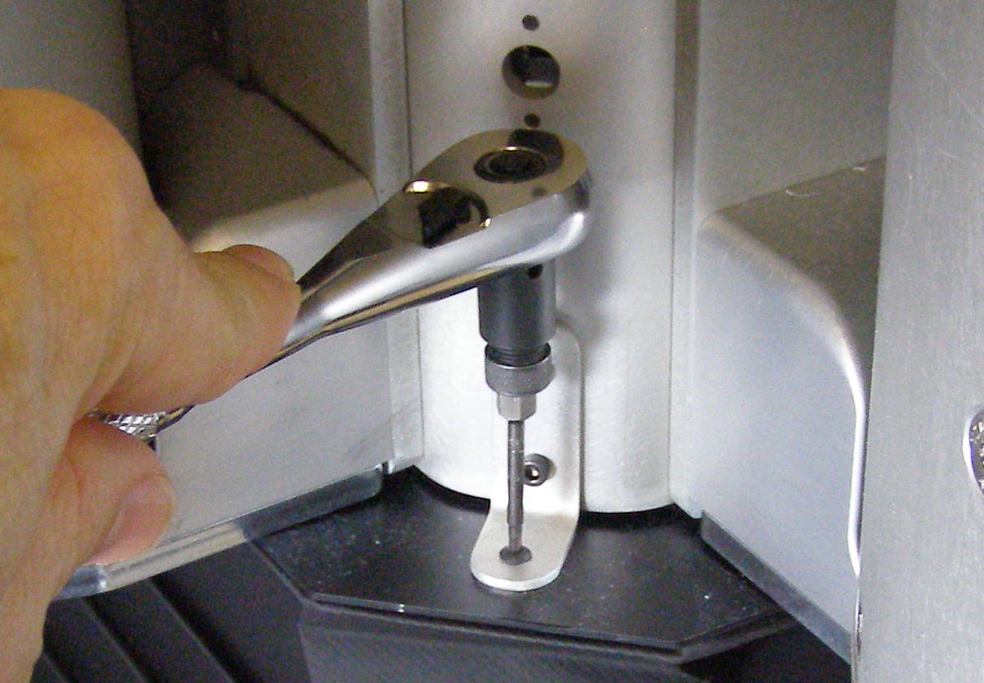
Bellows, Front R/R
Bellows, Front, Removal - 2161
  Raise the Spine at least 30cm
  Remove the Front Bottom Panel
  Remove the Center, Left, and Right Trim
  Using the 7/32 socket together with the ¼ drive ratchet wrench, and remove the 2 nuts. 1332 (Fig 1)
  Pull the Bellows by the lower plate forward until the studs clear the slot. (Fig 2)
  Using the 2mm bit together with the hex to ¼ adapter and the ¼ drive ratchet wrench, remove the 3 Buttonhead screws on the top edge of the Bellows. 2055-05 (Fig 3,4,5)
Fig 1
Fig 4
Fig 1
Fig 5
Fig 2
  To remove the Bellows pull forward and slightly up so that the tabs come out of their slots. (Fig 4)
Bellows, Front, Install
  Reverse the removal procedure making sure the tabs on the rear of the Bellows bottom plate is inserted into the slots on the chassis.
  Using Loctite 248, install the 3 screws and torque to 0.34Nm using the Small torque driver. Install the 2 nuts and torque to 1.36Nm using the Large torque driver.
Fig 7
Fig 3

Slide 3
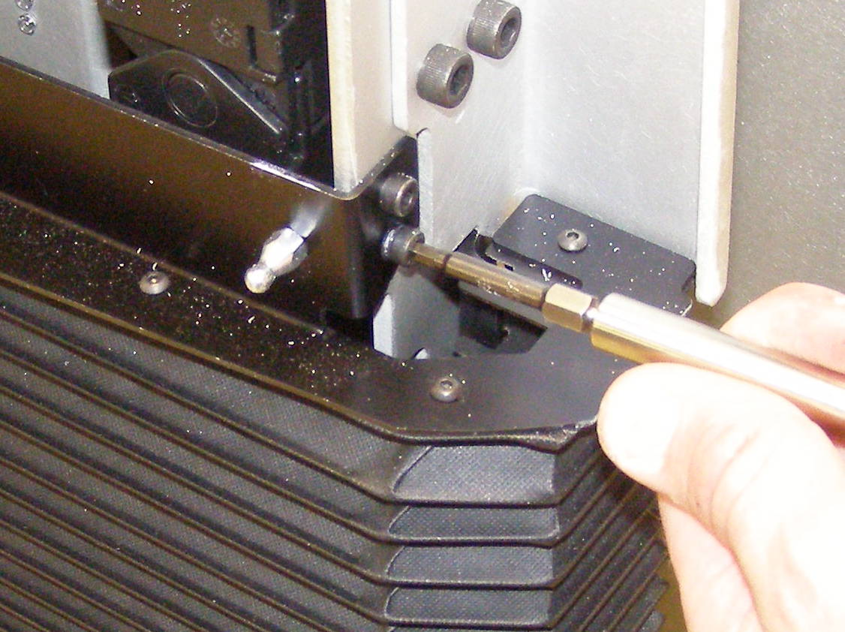
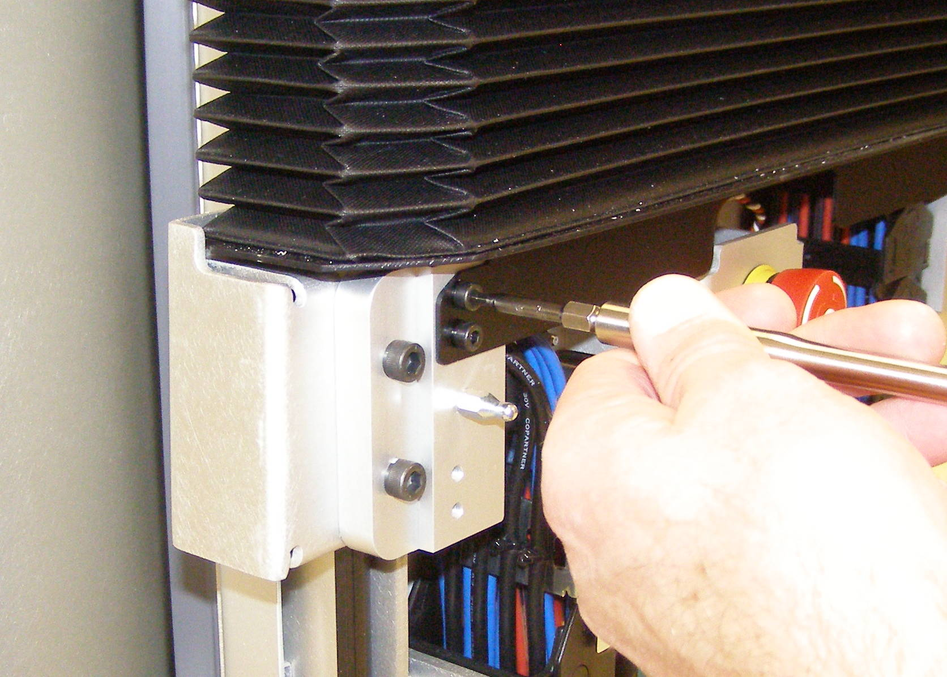
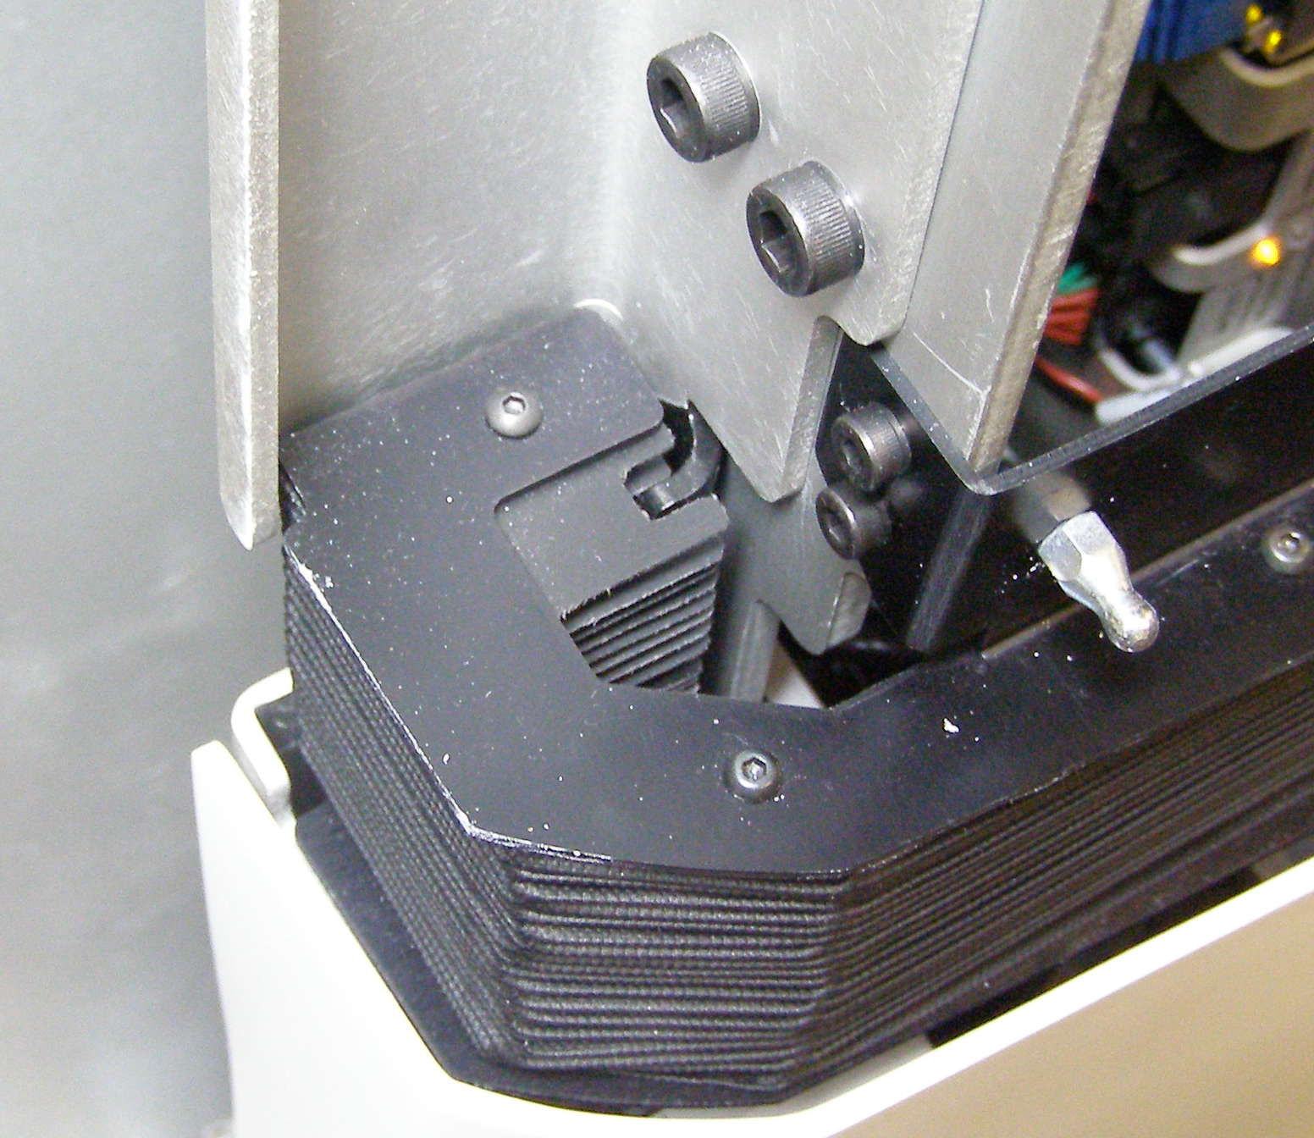
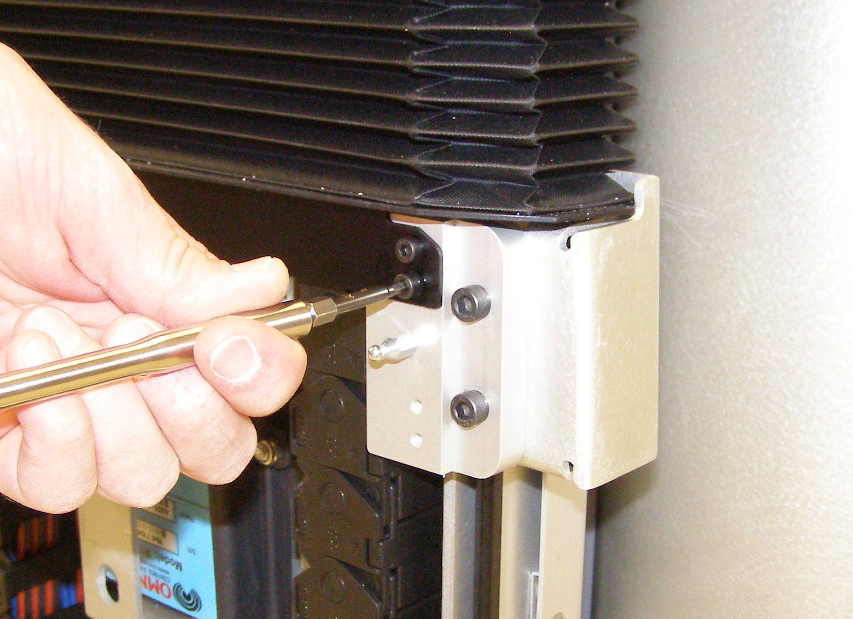
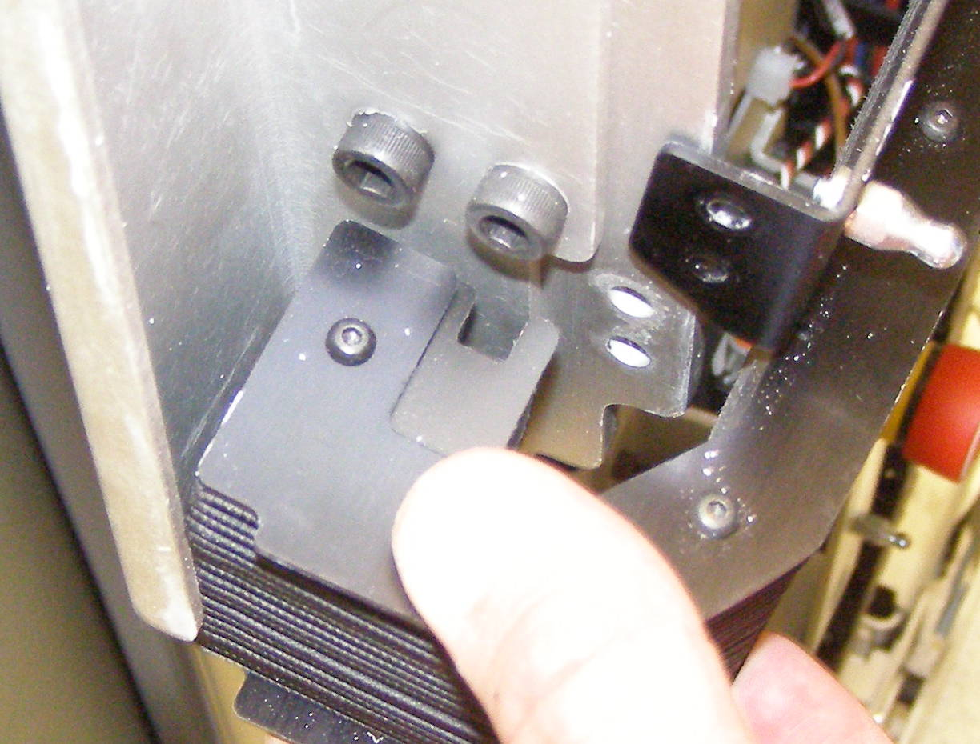
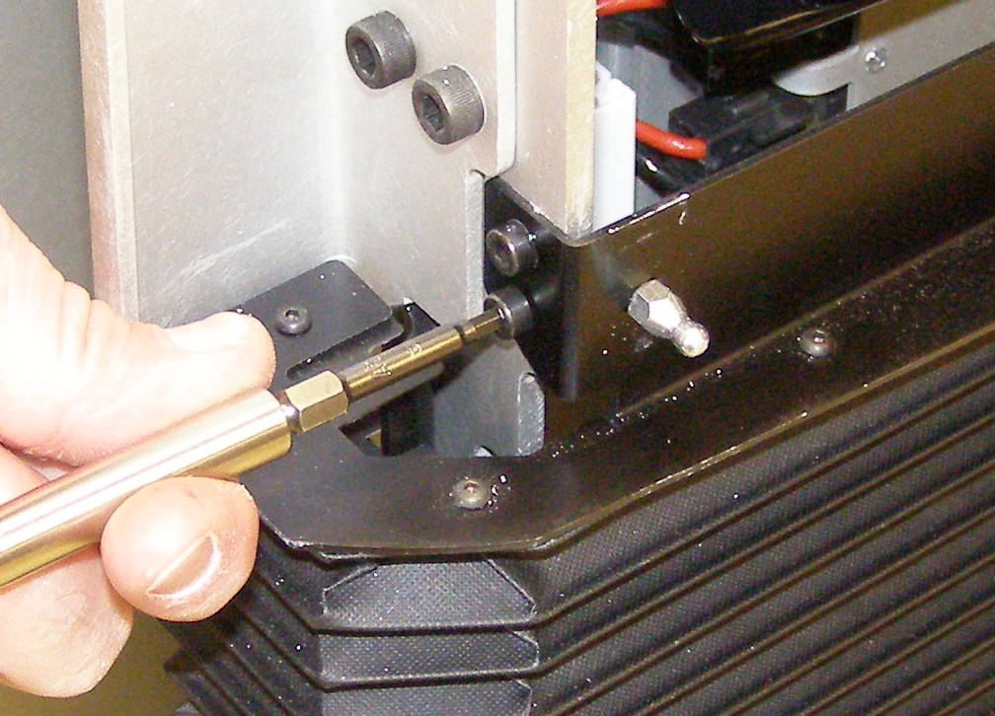
Bellows, Rear R/R
Bellows, Rear, Removal - 4287
  Remove the Rear Bottom Panel
  Remove the Top Rear Panel
  Using the 3mm bit with the T-handle driver, remove the 4 bottom screws. 3063-18 (Fig 1,2)
  Using the 3mm bit with the T-handle driver, remove the 4 top screws. (Fig 3,4)
Fig 4
  Squeeze the bellows together and lift up and off the end of the Slide Rail as you pull it gently out. (Fig 5,6)
Bellows, Front, Install
  Reverse the removal procedure.
  Using Loctite 248, install the 4 top and 4 bottom screws and torque to 3.17Nm using the Large torque driver.
Fig 1
Fig 5
Fig 2
Slide Rail
Fig 7
Lift up and pull out
Fig 3

